Slide 1

E020 – DOCTORADO EN TRANSFERENCIAS INTERCULTURALES E HISTÓRICAS
EN LA EUROPA MEDIEVAL MEDITERRÁNEA
Autism Awareness
International On-line Symposium La Nucia July 2025
Dimitrios Karantonis
PhD Candidate at the University of Alicante

Slide 2
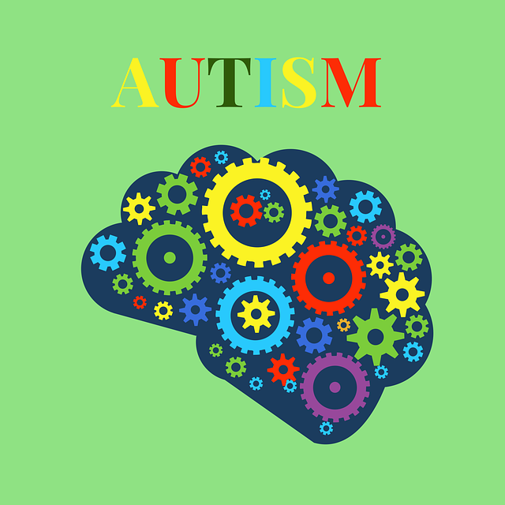
Autism Awareness
Understanding Autism Spectrum Disorder (ASD)

Slide 3
What is Autism?
Autism is a neurodevelopmental disorder that affects how people perceive the world and interact with others.
Key Characteristics:
-Difficulty in communication and social interactions
- Repetitive behaviors
- Unique strengths and differences

Slide 4
Signs and Symptoms
Common Signs:
- Delayed speech or language skills
- Avoidance of eye contact
- Repetitive movements (e.g., hand flapping)
- Intense interest in specific topics
- Difficulty understanding social cues

Slide 5
Types of Autism
ASD includes:
- Autism Disorder
- Asperger's Syndrome
- Childhood Disintegrative Disorder
- Pervasive Developmental Disorder - Not Otherwise Specified (PDD-NOS)

Slide 6
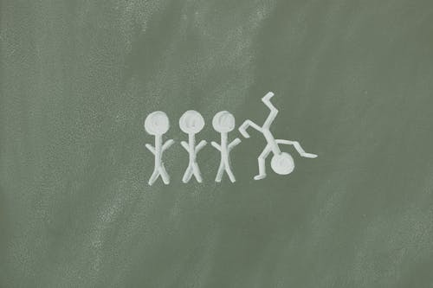
Causes and Risk Factors
Potential Factors:
- Genetic influences
- Environmental factors
- Prenatal complications
- Family history of autism

Slide 7
Diagnosis and Early Intervention
Diagnosis typically involves behavioral assessments and medical evaluations.
Early intervention can significantly improve quality of life.

Slide 8

Challenges…
Challenges:
- Sensory sensitivities
- Social communication difficulties
- Anxiety and emotional regulation

Slide 9
…and Strengths
Strengths:
- Strong attention to detail
- Unique problem-solving abilities
- Exceptional memory

Slide 10
Support and Resources
Support includes:
- Speech and occupational therapy
- Special education programs
- Family and peer support
- Advocacy groups and online resources

Slide 11
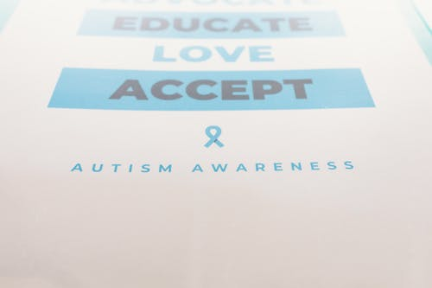
Conclusion
Understanding and supporting individuals with autism leads to more inclusive and compassionate communities.

Slide 12
References
American Psychiatric Association (APA). (2022). Diagnostic and Statistical Manual of Mental Disorders (DSM-5-TR).
Autism Speaks. (2025). Understanding Autism Spectrum Disorder.
National Institute of Mental Health (NIMH). (2025). Autism Spectrum Disorder.
- World Health Organization (WHO). (2025). Autism Spectrum Disorders.

Slide 13
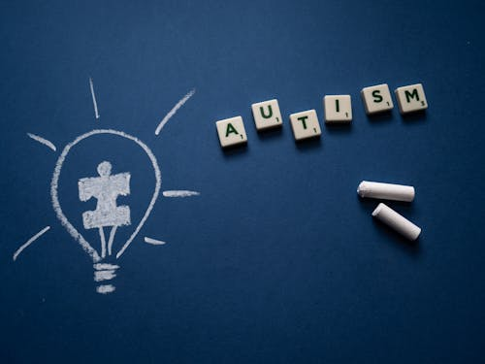
Thank you!!!

